Slide 1
ISML Biomedical – Summer Kickstart Meeting
Intelligent Sensory Microsystems Laboratory
University of Toronto
May 3rd 2021

Slide 2
Agenda
Logistics for the summer internship
Initial reading material + project description updates
Software and hardware requirements

Slide 3
Agenda
Logistics for the summer internship
Initial reading material + project description updates
Software and hardware requirements

Slide 4
Logistics
Everything done remotely!
Microsoft Teams
Invitation to be sent today
Let’s use that platform for chats + meetings
Weekly meeting – Fridays 10:00-10:30AM EDT
Sync-up with all summer students
Every student should prepare a 1-2-slide update (max 3 min)
Daily meetings will be arranged separately

Slide 5
Messaging and meetings
Feel free to message us with questions anytime!
We will use “Channels” in Microsoft Teams to discuss some specifics projects – feel free to use the space there to collaborate with other students
We will try to send reminders to extraordinary meetings two days in advance

Slide 6
Weekly hours + conflict with summer courses
Full-time students are expected to work 40h per week – you are flexible to allocate these hours between week / weekend days
For part-time students: by default, we expect that you should work 20h to 30h per week – let us know if you need to adjust some of those expectations
Let us know if you are taking any courses this summer, and if you have any time slots that you will not be available

Slide 7
Weekly, midterm and final presentation/reports
For each weekly meeting, you are expected to prepare 1 or 2 slides with a quick summary you have accomplished that week
You are also expected to present your progress halfway through the summer – at the end of June (date TBD)
At the end of the internship, you will need to compile your achievements in a short presentation and a final report – more details TBD
Keeping journal notes and tracking your weekly slides is a good way to prepare for the midterm and final presentation and reports!

Slide 8
Agenda
Logistics for the summer internship
Initial reading material + project description updates
Software and hardware requirements

Slide 9
Initial reading material
Zotero – reference organization software – create an account =)
General review papers on neural interfaces
1) J. Yang and M. Sawan, “From Seizure Detection to Smart and Fully Embedded Seizure Prediction Engine: A Review,” IEEE Transactions on Biomedical Circuits and Systems, 2020.
2) B. Zhu, U. Shin, and M. Shoaran, “Closed-Loop Neural Interfaces with Embedded Machine Learning,” arXiv:2010.09457 [cs], Oct. 2020.
3) J. A. Frank, M.-J. Antonini, and P. Anikeeva, “Next-generation interfaces for studying neural function,” Nature Biotechnology, vol. 37, no. 9, Art. no. 9, Sep. 2019.
4) P. Jastrzebska‐Perfect et al., “Translational Neuroelectronics,” Advanced Functional Materials, vol. 30, no. 29, p. 1909165, 2020.
5) L. Luan et al., “Recent Advances in Electrical Neural Interface Engineering: Minimal Invasiveness, Longevity, and Scalability,” Neuron, vol. 108, no. 2, pp. 302–321, Oct. 2020.
6) K.-W. Yang, K. Oh, and S. Ha, “Challenges in Scaling Down of Free-Floating Implantable Neural Interfaces to Millimeter Scale,” IEEE Access, vol. 8, pp. 133295–133320, 2020.

Slide 10
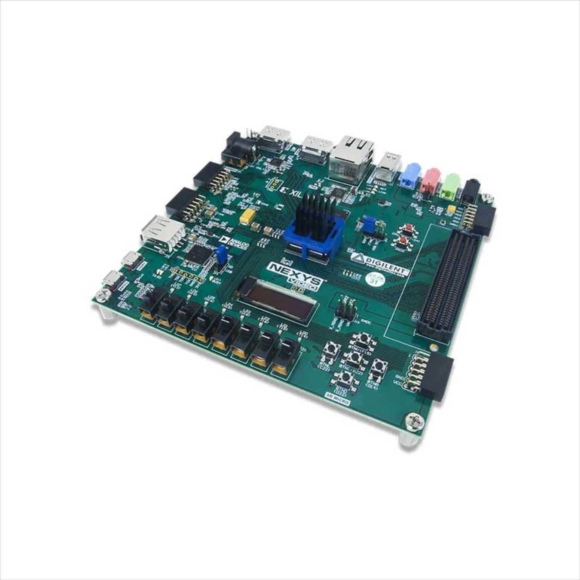
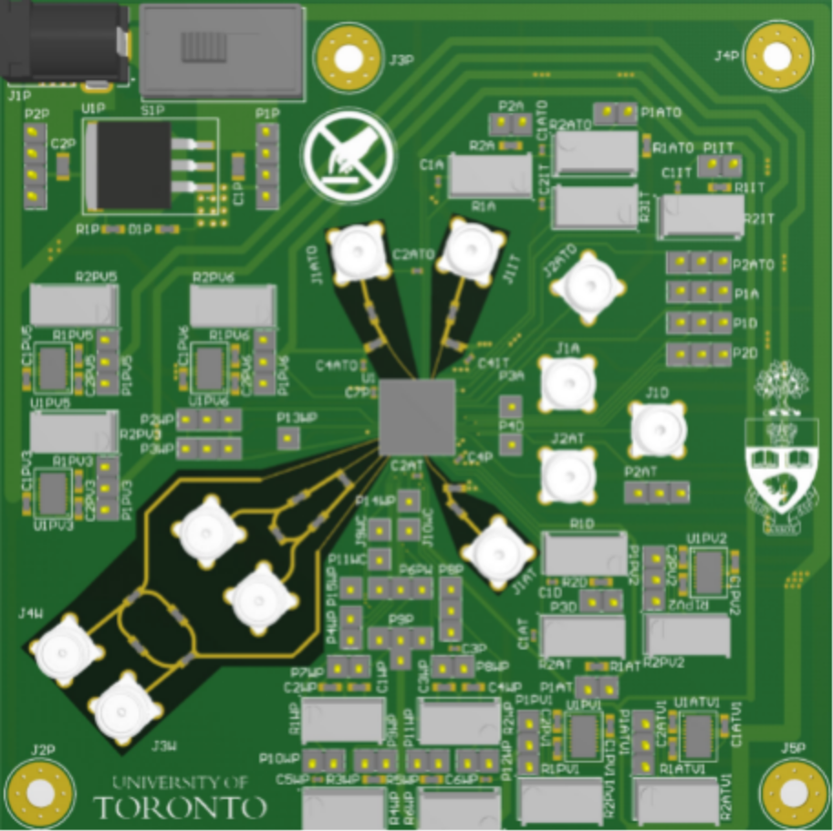
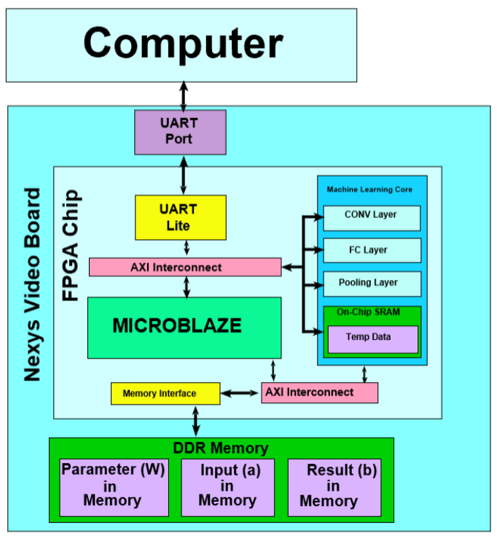
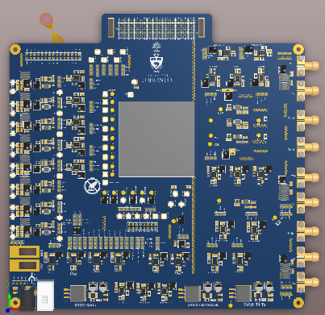
Summer task groups
FPGA development group
- Albert, Hao, Patty
PCB / Wireless design group
- Guozhen, Arielle

Slide 11
FPGA Development

Slide 12
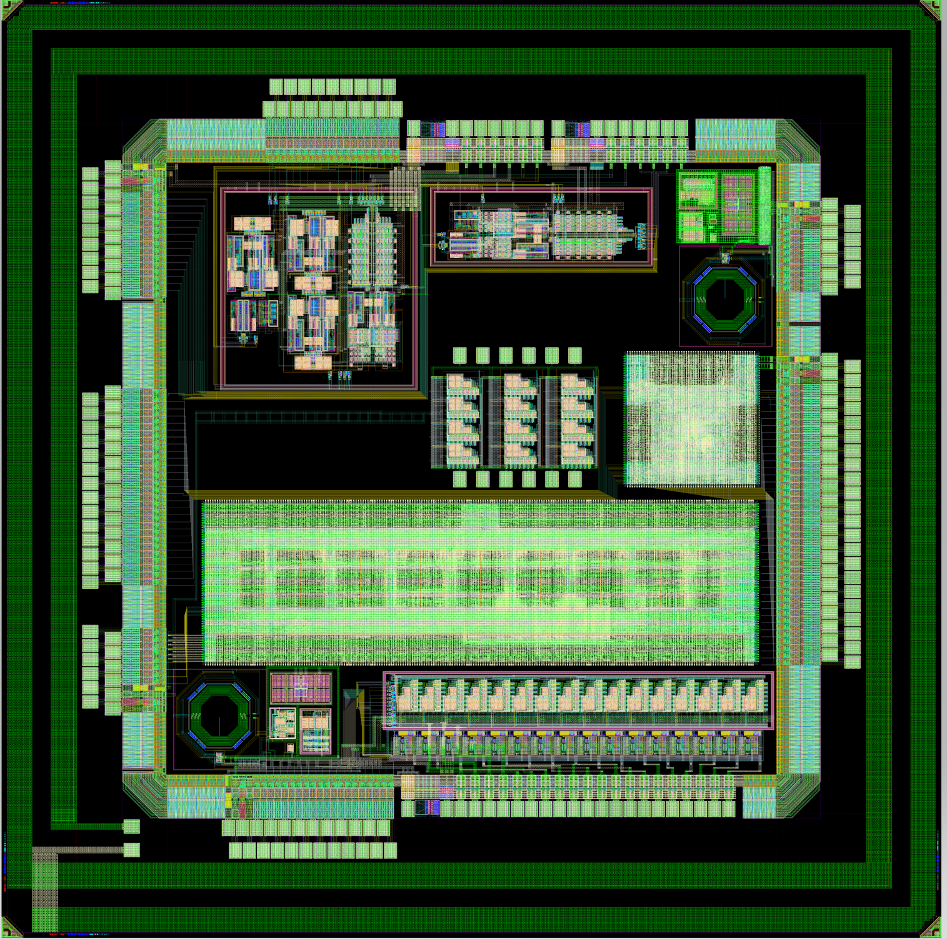
PCB Design

Slide 13
Project description update – Albert
Title: Low-energy Hardware for Seizure Detection & Prediction
Goal for this summer: simplify previous machine learning algorithm to fit on a lower power FPGA
Starting point: Karissa’s 2020 implementation
Additional starting reading material:
1) Karissa’s final report

Slide 14
Project description update – Patty
Title: PNS Neural Pathway Classifier on Low-power FPGA
Goal for this summer: simplify previous CNN implementation to fit on lower power FPGA, implement new version of PNS classifier
Starting point: Samantha’s 2020 implementation, meeting with Eugene (Prof. Zariffa’s group)
Additional starting reading material:
Samantha’s final presentation
Ryan Koh’s papers on the neural pathway CNN
Zotero -> Summer 2021 -> PNS Project

Slide 15
Project description update – Hao
Title: Digital Design for Non-uniform Sampling in Neural Analog Front-ends
Goal for this summer: implement digital blocks to connect with non-uniform quantized sampling front-end, designed by Jianxiong
Starting point: get acquainted on how the non-uniform sampling filter works
Additional starting reading material:
Papers on non-uniform sampling
Zotero -> Summer 2021 -> Non-uniform sampling

Slide 16
Project description update – Guozhen
Title: Design of Testboards for Neural Interface ICs
Goal for this summer: assist in several PCB design efforts to test chips designed by the lab
Starting point: get acquainted with PCB design software, and re-design analog CLS-2020 PCB testboard to fit a new IC package
Additional starting reading material:
Altium tutorials
Altium files from CLS-2020 PCB testboard

Slide 17
Project description update – Arielle
Title: Design of Testboard for Memristor IC Characterization
Goal for this summer: design a test PCB to house a memristor
Starting point: get acquainted do PCB design software, read papers on memristor devices
Additional starting reading material:
Altium tutorials
Papers on memristor interfaces
Zotero -> Summer 2021 -> Memristor Interfaces

Slide 18
Agenda
Logistics for the summer internship
Initial reading material + project description updates
Software and hardware requirements

Slide 19
Software and hardware requirements
FPGA Development (Albert, Hao, Patty)
Vivado
Tutorials: links to be provided by Jay
PCB Design (Arielle, Guozhen)
Altium Designer
Tutorials:
From Idea to Manufacture - Driving a PCB Design through Altium Designer
Fedevel Academy Altium Beginner Series – (5h)

Slide 20
Software and hardware requirements (2)
FPGA boards
Two options:
Ship boards to students, so they can run their codes at their home
Set up a remote testbench that you can access remotely

Slide 21
Action items for now
Read review papers #1 and #2
(Optional) Read other review papers if you are interested =)
For FPGA folks: install and make sure Vivado works in your machine, and start doing the tutorials
For PCB design folks: install and make sure Altium works in your machine, and start doing the tutorials

Slide 22
Intelligent Sensory Microsystems Laboratory
Thank you!
QUESTIONS?
University of Toronto
May 3rd 2021

